Slide 1
DC motor Driver using Transistors
RAFAY AAMIR GULL BSEE19047
MUHAMMAD HASSAAN BSEE19056
MUHAMMAD AETISAM BSEE19043

Slide 2

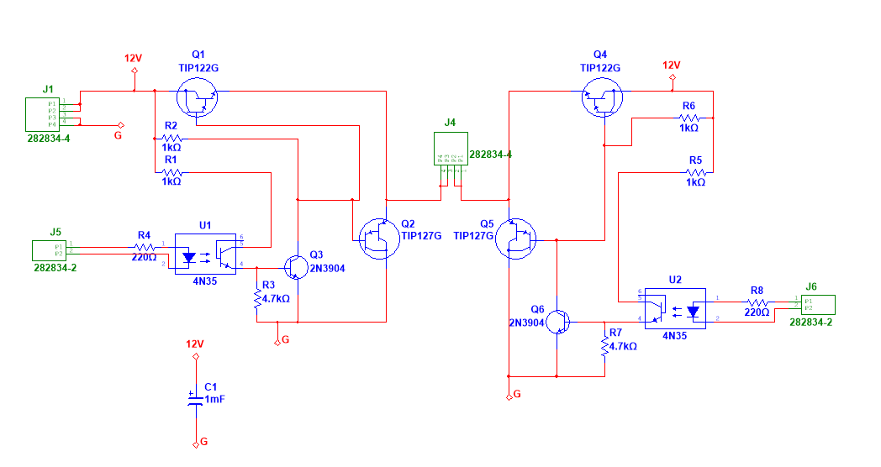

Circuit Diagram
Components:
TIP122 (NPN Darlington Transistor)
TIP127 (PNP Darlington Transistor)
2N3904 (NPN BJT Transistor)
4N35 (Optocoupler)Infrared emitter diode drives a phototransistor

Slide 3

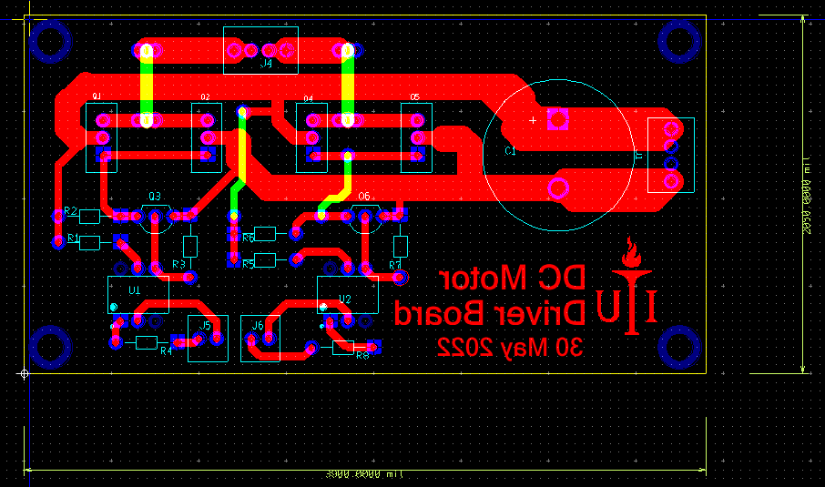
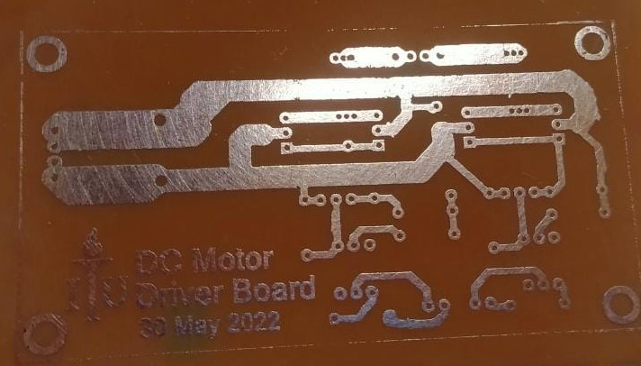
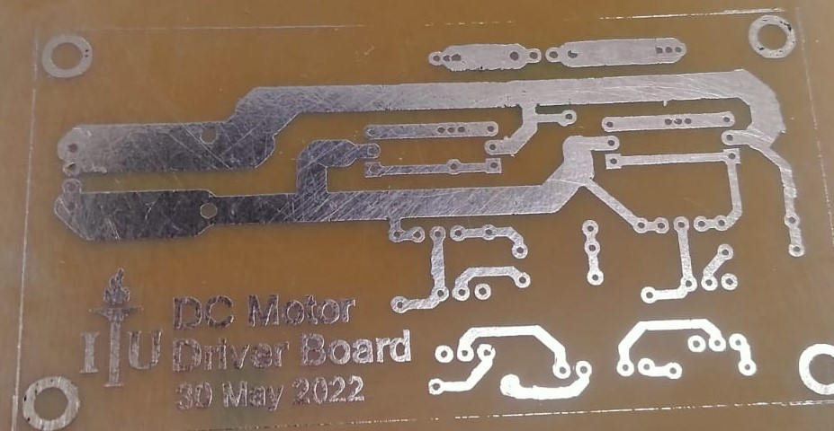
PCB Design

Slide 4
Apply 12V to the J1 Terminal Block
Common the Cathode Side of 4N35 of terminal J5 and J6
Burn the code and then connect the DC motor to Terminal Block J4
The other two pin of terminal block to Arduino UNO PWM pin (D9,D10).
We can Change the PWM of the motor using command analogWrite(PWM_output,0-255)

